Slide 1

“Traffic Sign Recognition”
Deogiri Institute of Engineering and Management Studies, Chhatrapati Sambhaji nagar
Department of (CSE)Artificial intelligence and machine learning
A presentation of CA-I Deep Learning on topic
Presented by :
Mr. Kunal Laxminarayan Jajure (TY/AIML)
Roll no: 3775

Slide 2
Contents
What is traffic sign classification?
Problem Statement
Objectives of the project
Study Resources
Pros and Cons of existing systems
Scope of the project
Boundaries of the project
Dataset for the project
Methodology for the project

Slide 3
What is traffic signs classification
When you go on the road, you see various traffic signs like traffic signals, turn left or right, speed limits, no passing of heavy vehicles, no entry, children crossing, etc., that you need to follow for a safe drive.
The methodology of recognizing which class a traffic sign belongs to is called Traffic signs classification.

Slide 4
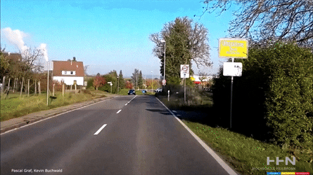
Example of Traffic Sign Recognition

Slide 5
Problem Statement
Traffic sign detection and recognition have gained importance with advances in image processing due to the benefits that such a system may provide. The recent developments and interest in self-driving cars have also increased the interest in this field.
Automatic detection and recognition of traffic signs is very important and could potentially be used for driver assistance to reduce accidents. There are many sign boards on roads that people are unaware of. They might have seen traffic or road signs all the time but don’t understand what those signs are indicating.
Our Traffic Sign Recognition System detects and recognizes road signs or traffic signs from an image and video. It will also recognize signs in real-time.

Slide 6
Objectives of the project
To understand the problem of traffic sign detection and recognition in depth and exploring different solutions available.
To study and explore working of traffic sign detection and recognition system.
To Design ANN based solution for the traffic sign recognition problem.
To improve the model accuracy with the help of different experimentations.

Slide 7
Study Resources
https://www.google.com/search?q=traffic+sign+recognition+links&oq=traffic+sign+recognition
https://www.analyticsvidhya.com/blog/2021/12/traffic-signs-recognition-using-cnn-and-keras-in-python/
https://www.sciencedirect.com/science/article/pii/S2046043022000557
https://ieeexplore.ieee.org/document/4782748

Slide 8
Pros and cons of existing systems
Pro:
They have implemented this type of problems on video and photos data, in which you have to upload videos or photos.
Cons:
They don’t work on realtime data fetched through camera.

Slide 9
Scope of the project
It is easy to maintain.
It is user-friendly.
The system automatically detects traffic signs.
It can recognize signs from an image and videos.
It can also detect and recognize in real-time.

Slide 10
Boundaries of the project
The uploaded/fetched image or video must contain traffic or road signs.
The system will detect signs in real-time only if the device camera is on.
The system won’t run simultaneously in the background.

Slide 11
Dataset for the project
The image dataset is consists of more than 50,000 pictures of various traffic signs(speed limit, crossing, traffic signals, etc.) Around 43 different classes are present in the dataset for image classification. The dataset classes vary in size like some class has very few images while others have a vast number of images.
the file size is around 314.36 MB.

Slide 12
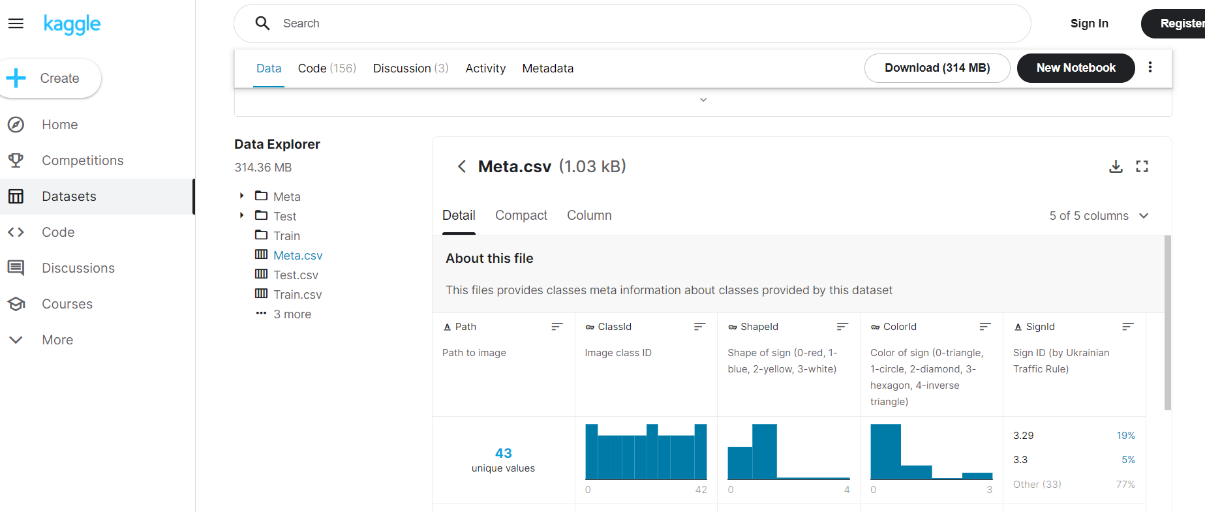
Dataset source image and link
https://www.kaggle.com/datasets/meowmeowmeowmeowmeow/gtsrb-traffic-sign

Slide 13
Methodology of the project
In this system, the user can upload an image for the system to detect and recognize traffic signs. For real-time traffic sign recognition, the user will need to turn on their device camera and click on the camera button to start detecting.
The system will display the names of the recognized traffic signs. It will also display the probability of the predicted result being accurate. The front-end involves Html, CSS, and JavaScript and the back-end involves Python. The Traffic Sign dataset is extracted from Kaggle. We can implement this system on a vehicle from a broader perspective and modify the vehicle by this system to behave as a sign detector in real-time.

Slide 14
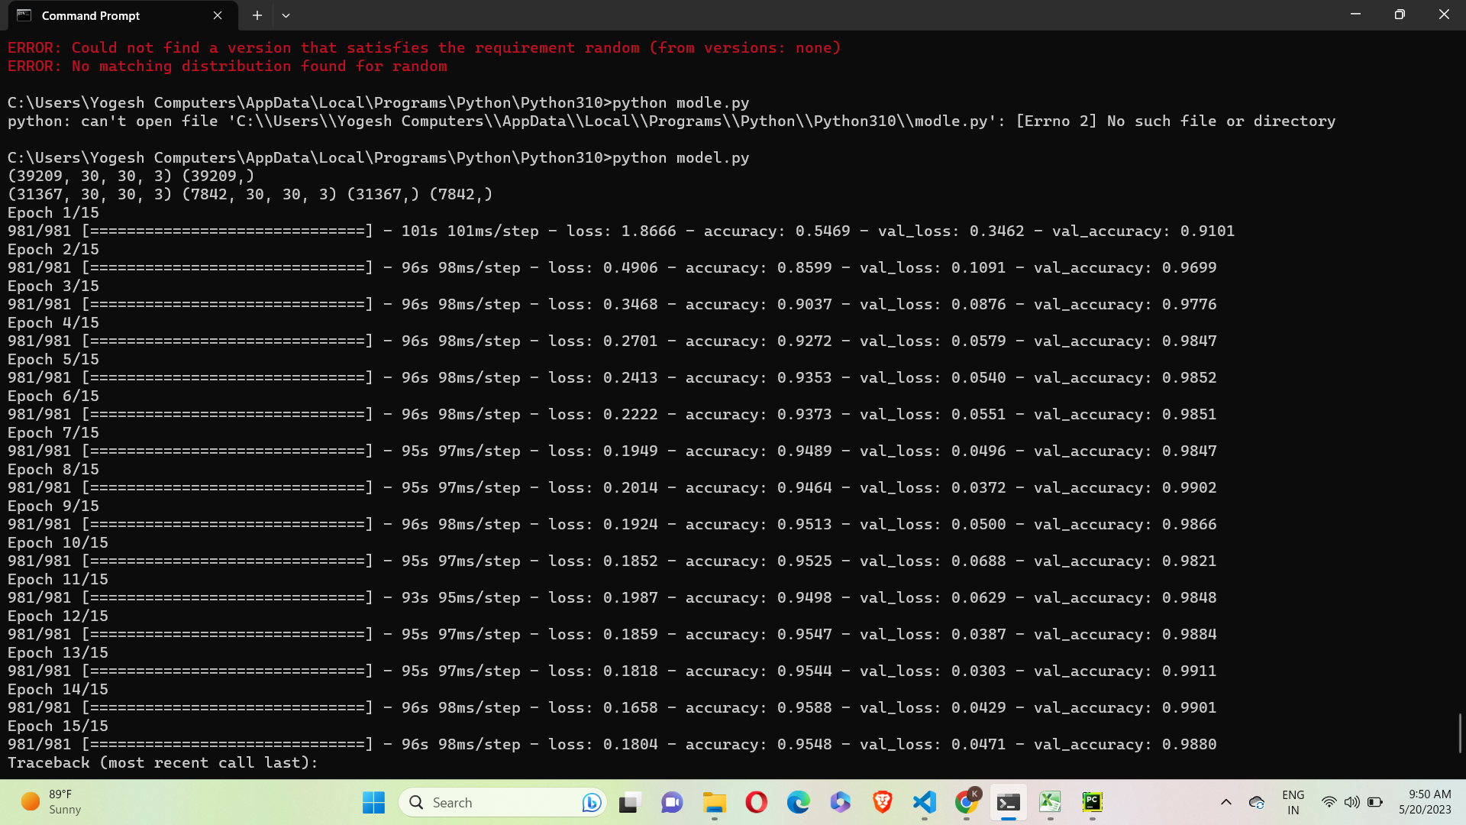
Model Accuracy 0.9880

Slide 15
Final output
First we have to upload the image by clicking upload the image button.
After uploading the image click on the Recognize sign.
Then app will recognize which sign it is.

Slide 16
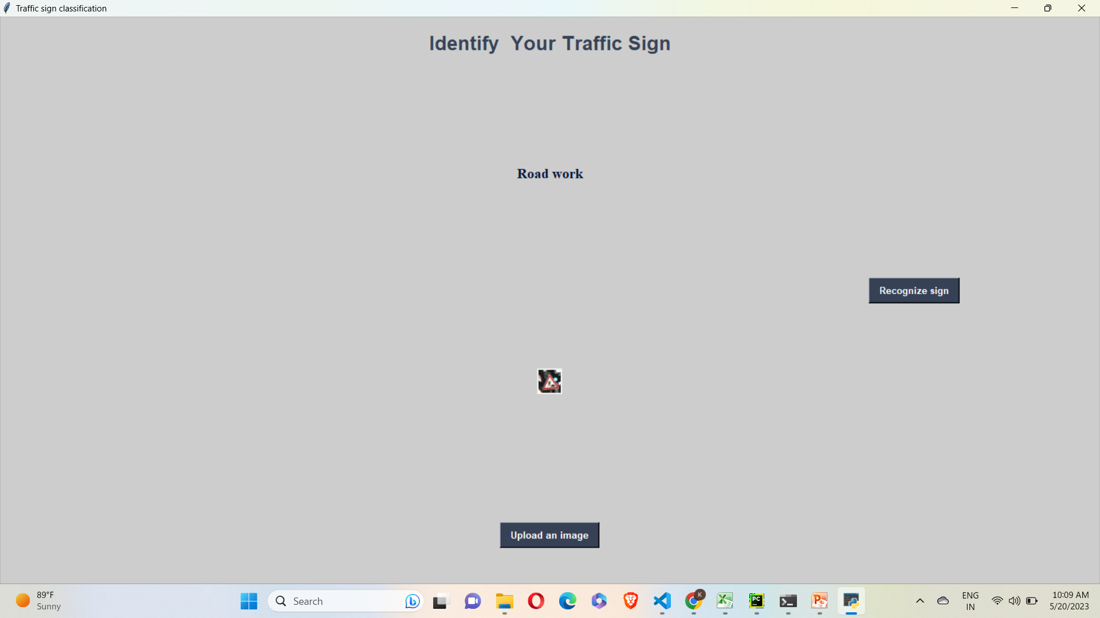
Road work sign identified.

Slide 17
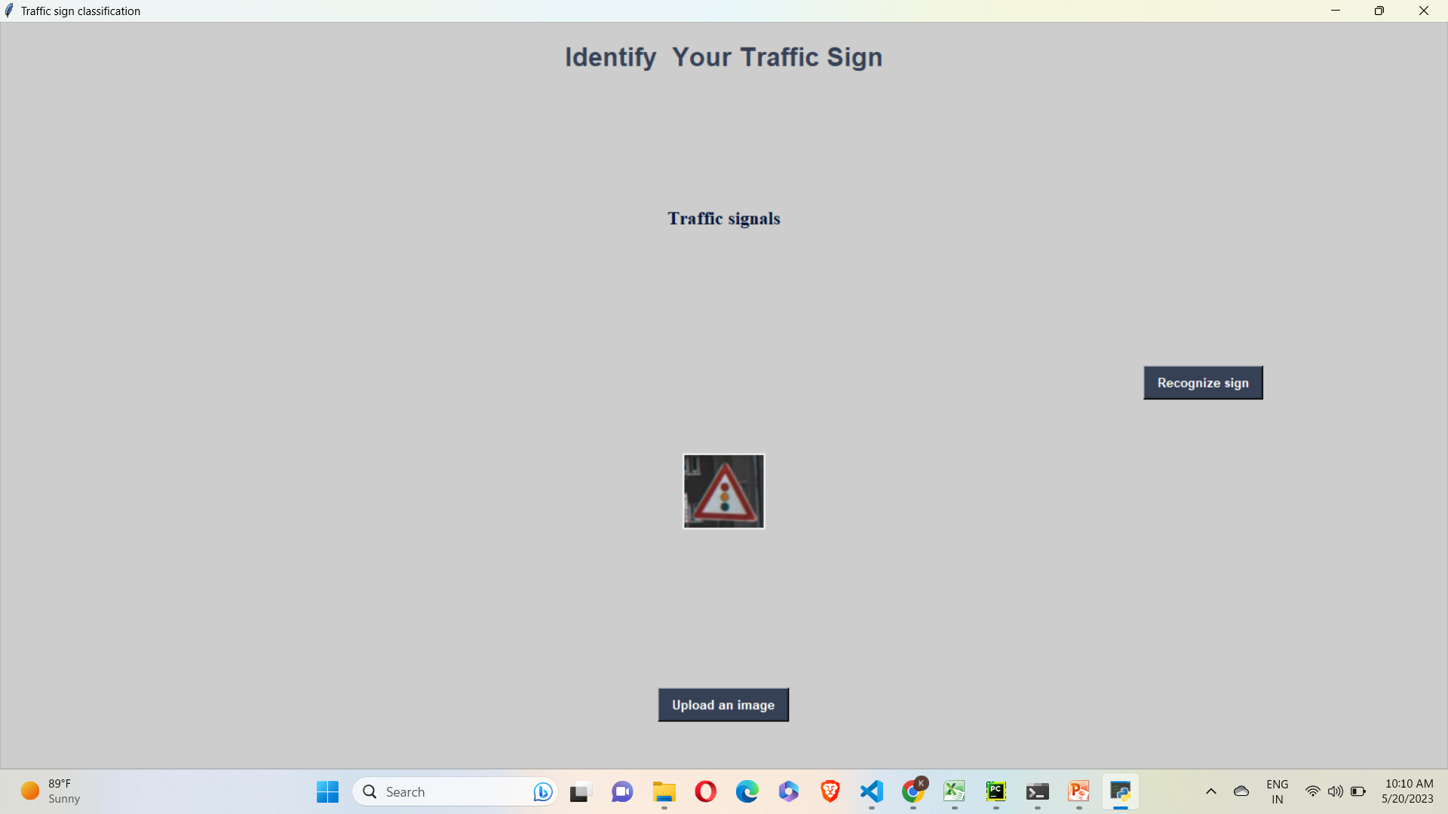
Traffic signals sign identified

Slide 18
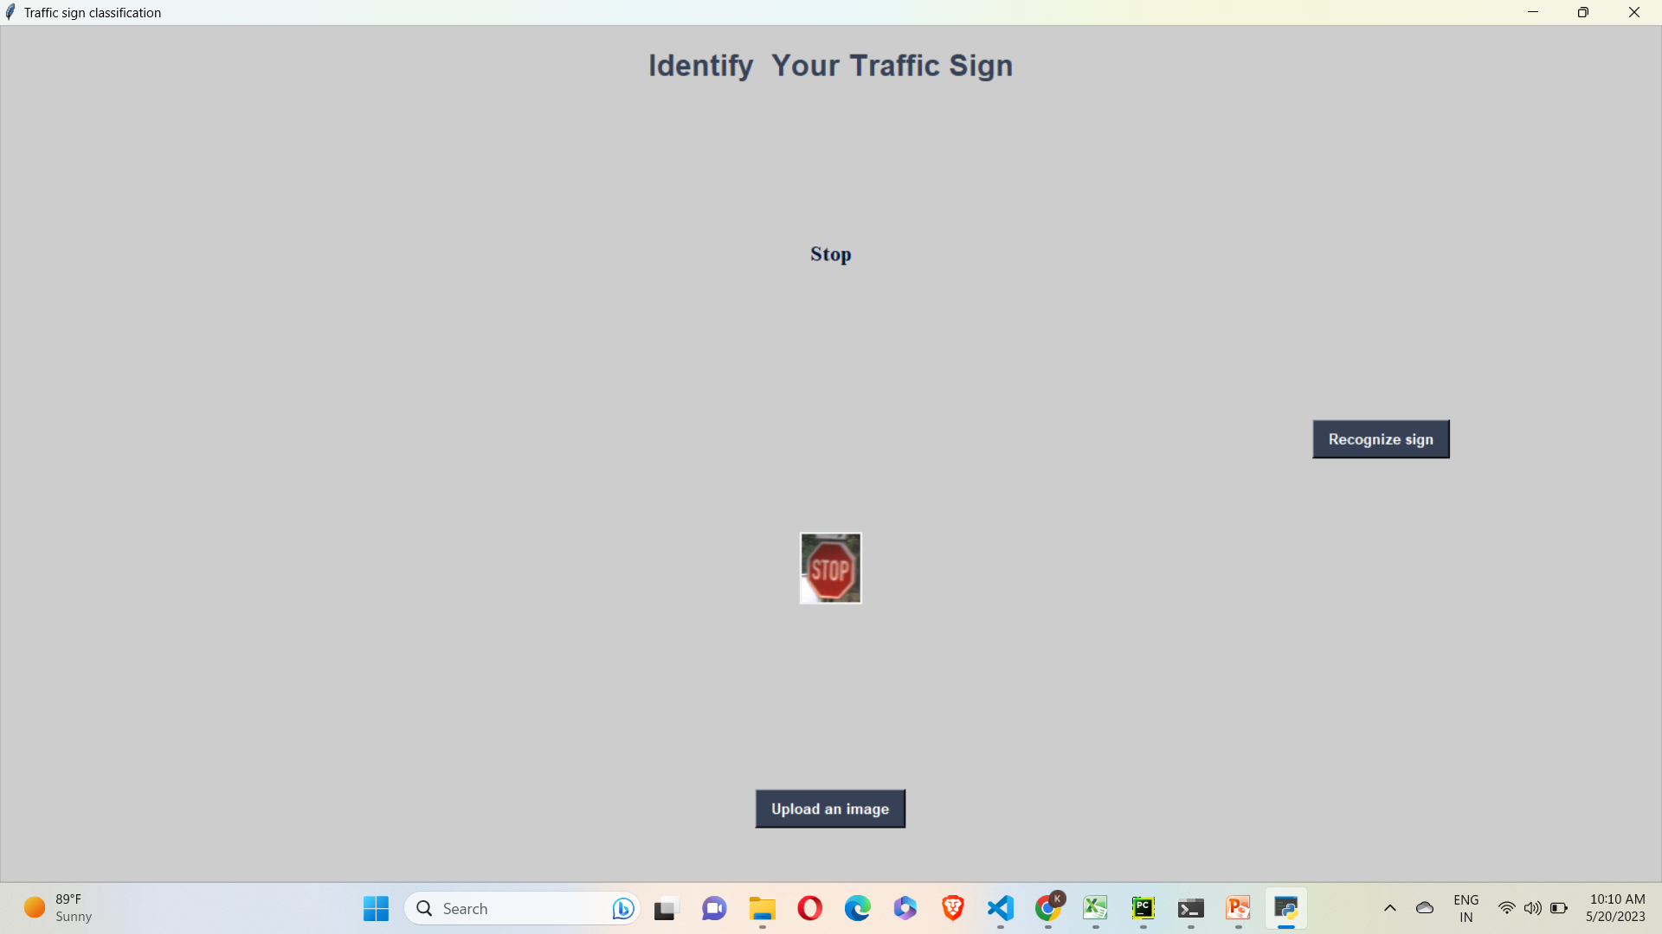
Stop sign identified.

Slide 19
Thank you!

